Slide 1
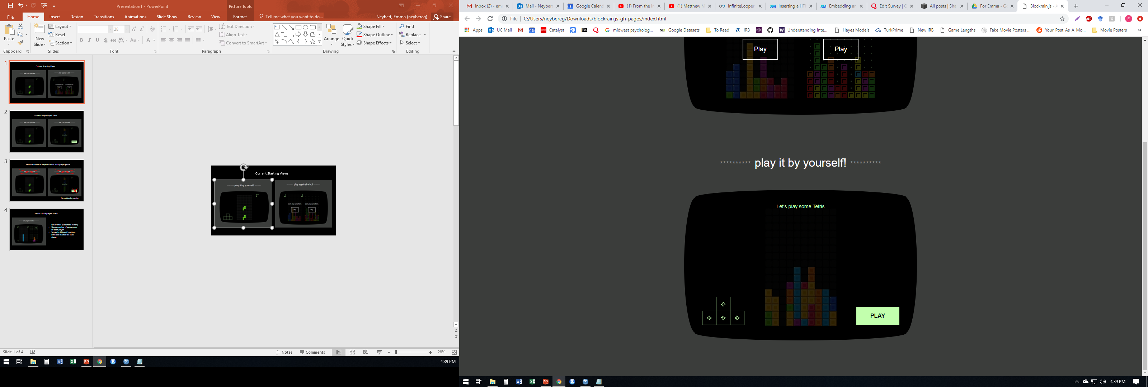
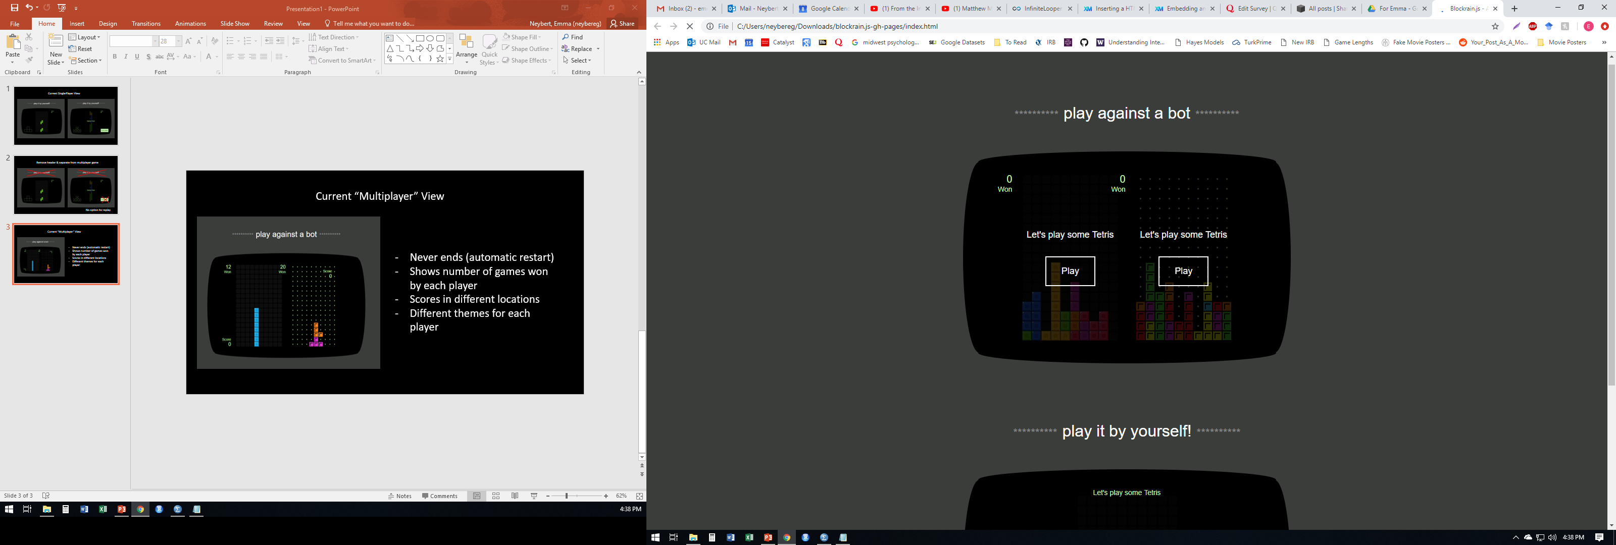
Current Starting Views

Slide 2
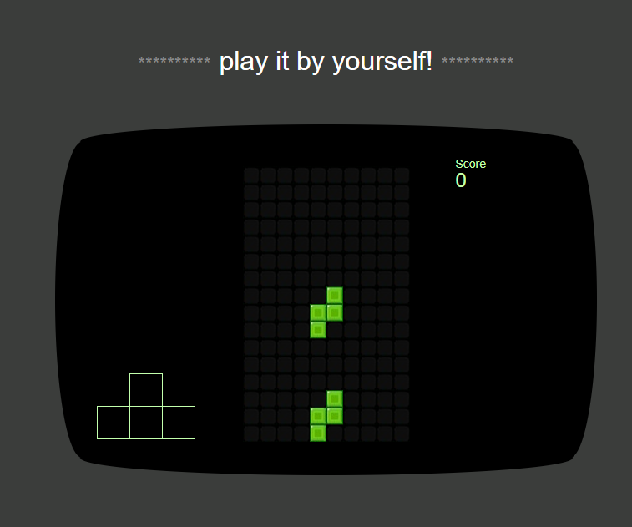
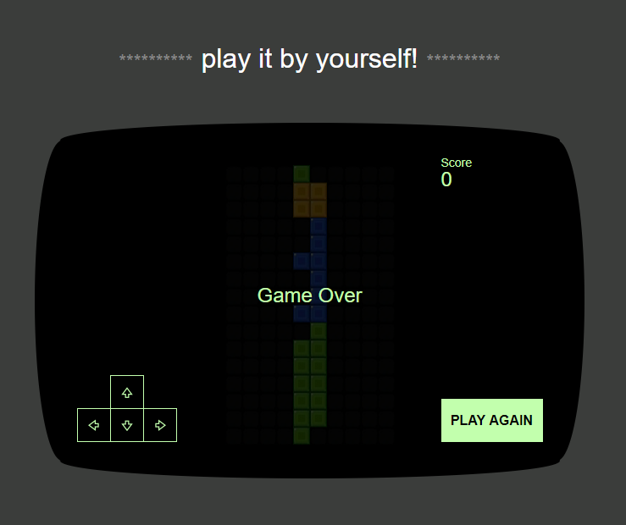
Current Single-Player View

Slide 3
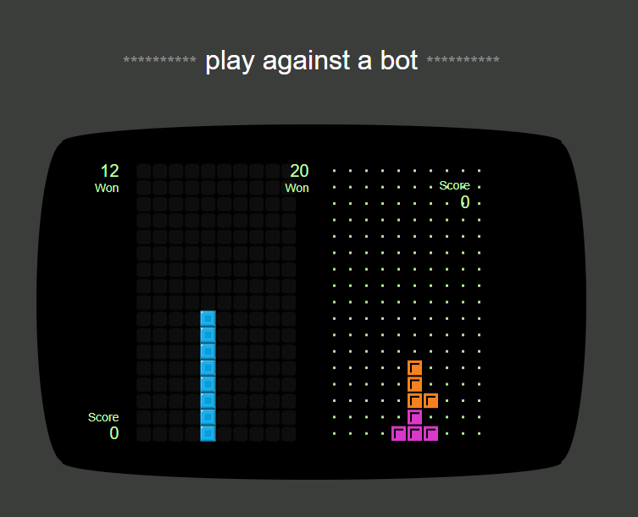
Current “Multiplayer” View
Never ends (automatic restart)
Shows number of games won by each player
Scores in different locations
Different themes for each player

Slide 4
Desired changes* - Separate 1P from AI/2P game - Remove headers, arrow key visuals, & games won counter - Visual consistency between 1P & AI/2P game *Visual depiction/details of changes on following slides.

Slide 5
Remove headers, arrow keys, and “Let’s play some Tetris”
Fill in play button on both modes like this and move to side if space allows – only one play button for multiplayer

Slide 6
Remove header
Don’t show arrow keys
No option for replay

Slide 7
Proposed “Multiplayer” View/Gameplay
Make AI really good (difficult mode) – almost always able to beat player
Game over when one player loses – overlay like in single player mode
Remove games won & header
Move scores to be at similar locations respective of the player (similar to single player mode)
Same theme for both players

